Slide 1

Supplier Contributions Review Board Meeting
July 22, 2024
Honeywell Internal

Slide 2
Meeting Agenda
Supplier Contributions Defined
Pre & Current SC Revision Process
SC Roadmap
SCRBM Walkthrough

Slide 3

Supplier Contributions Defined
The Supplier Contributions team is established to review solicitations in order to identify any rebates, allowances, and credits received by contractors; report, and support the remittance of credits and/or refunds to the U.S. Government
The Supplier Contributions team approves or rejects solicitations to use any item that meets thee supplier contribution criteria as outlined by AP-1814.

Slide 4
Supplier Contributions Comparison
Prior to Defined SC Process
Undefined Workflow.
Communication delays, gaps, and work stops
Inconsistent supplier contributions Inbox Management
Delayed Financial Verification.
Expired Buyer trainings
Current SC Process
Defined Workflow
Cross-Functional Teams synchronization
Finance Verification Form developed (AF-1373).
Improved tracking of pre-solicited contributions.

Slide 5
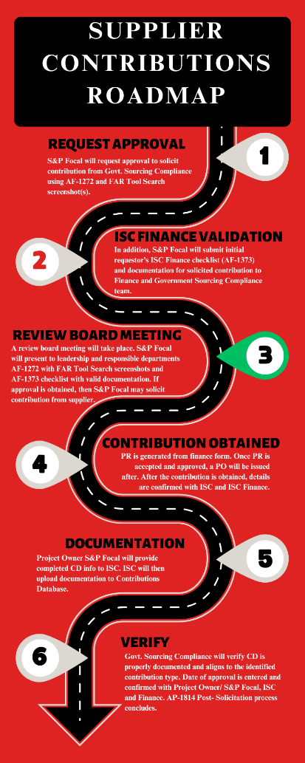
Supplier Contributions Roadmap

